Slide 1
HEALTHFY ME
Final Project for INFO5100 Application Engineering Development

Slide 2
TEAM RUNTIME TERROR
RISHAB SHEKAR GUNASHEKAR - 001040578
SRIRAM RAVINDRAN - 001003684
AISHWARYA YATIN SAMEL - 001554746

Slide 3
ABOUT ECOSYSTEM
The purpose of this application is to allow the users to get consultation on diet and exercise regime, take expert advice and connect to them to get their issues resolved, thus equipping them to maintain a healthy lifestyle.
Additionally, this application also manages the resources and responsibilities of each operational unit that is involved in this system.

Slide 4
PROBLEM STATEMENT
Need to understand the importance of being healthy.
Food and Diet plays a major role.
Importance of exercise cannot be stated enough!!
Its important to switch to healthy food.
HEALTHY BODY = HEALTHY MIND

Slide 5
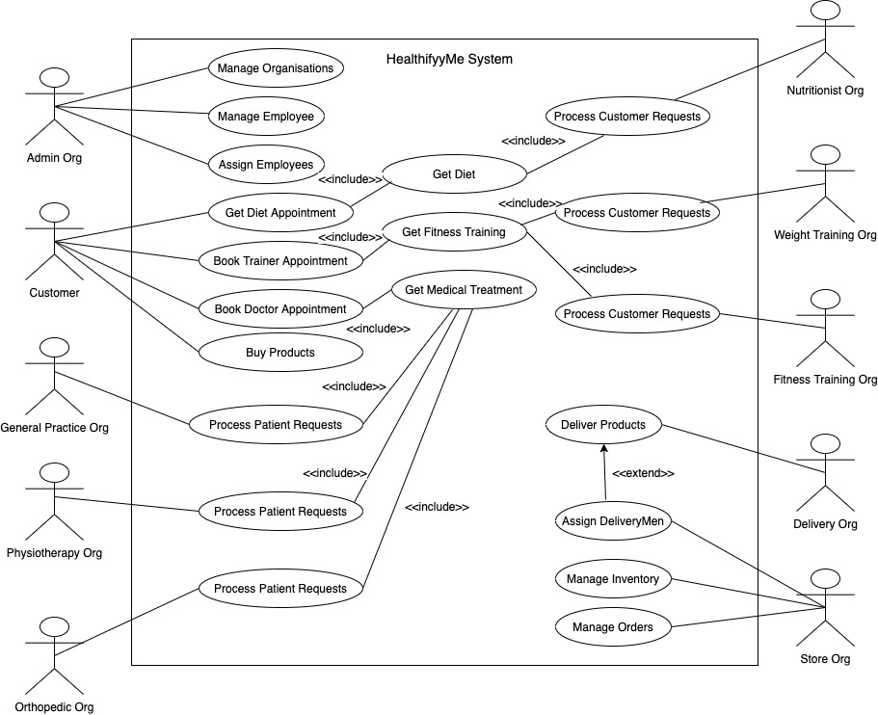
USE CASE DIAGRAM

Slide 6
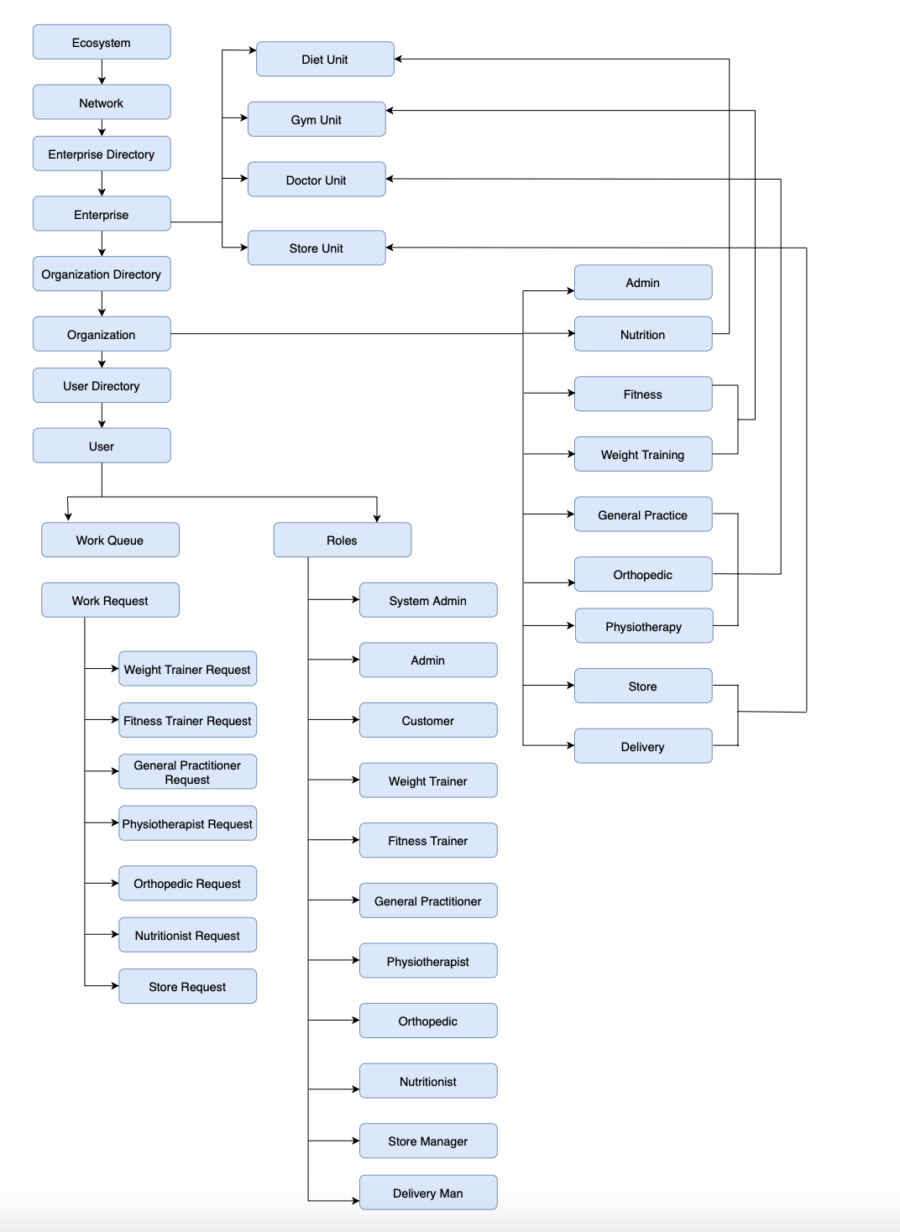
OBJECT MODEL DIAGRAM

Slide 7
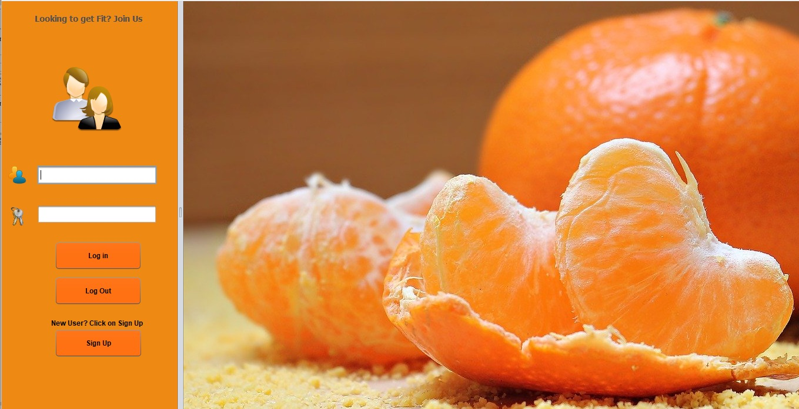
LOGIN SCREEN

Slide 8
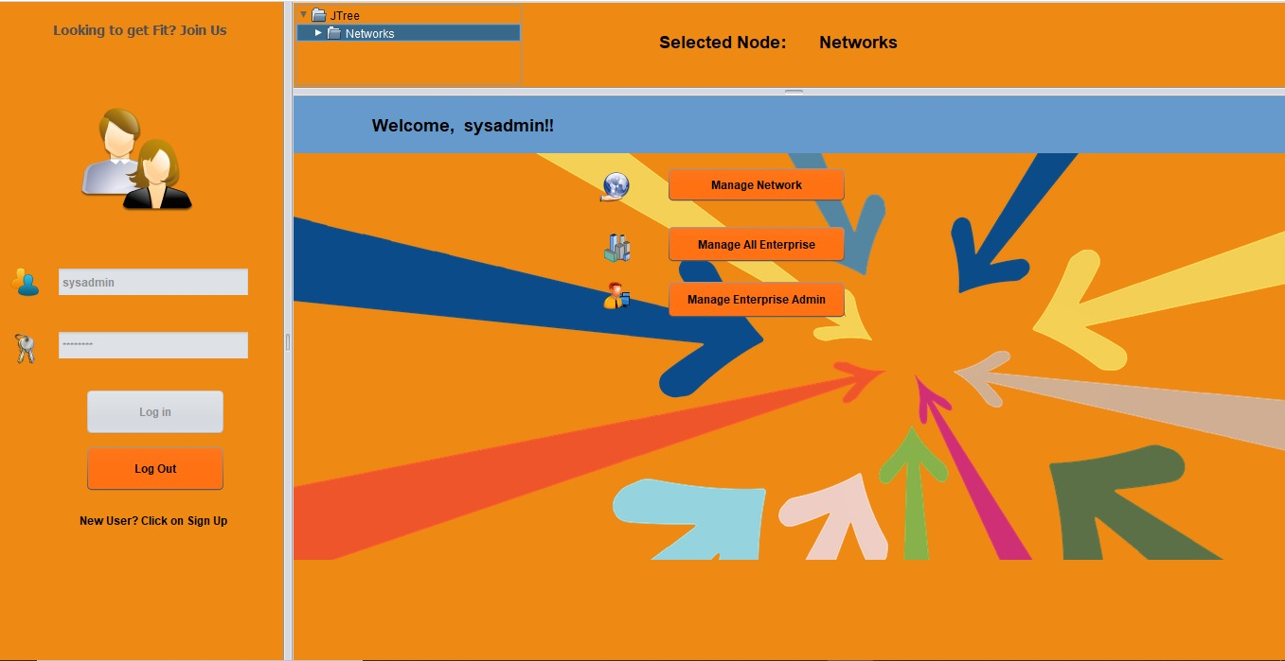
SYSTEM ADMINISTRATOR LANDING PAGE

Slide 9
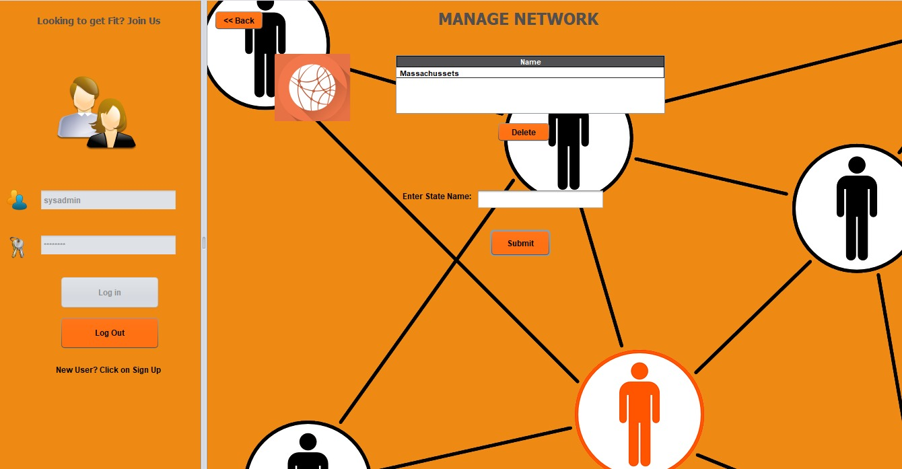
MANAGING NETWORKS

Slide 10
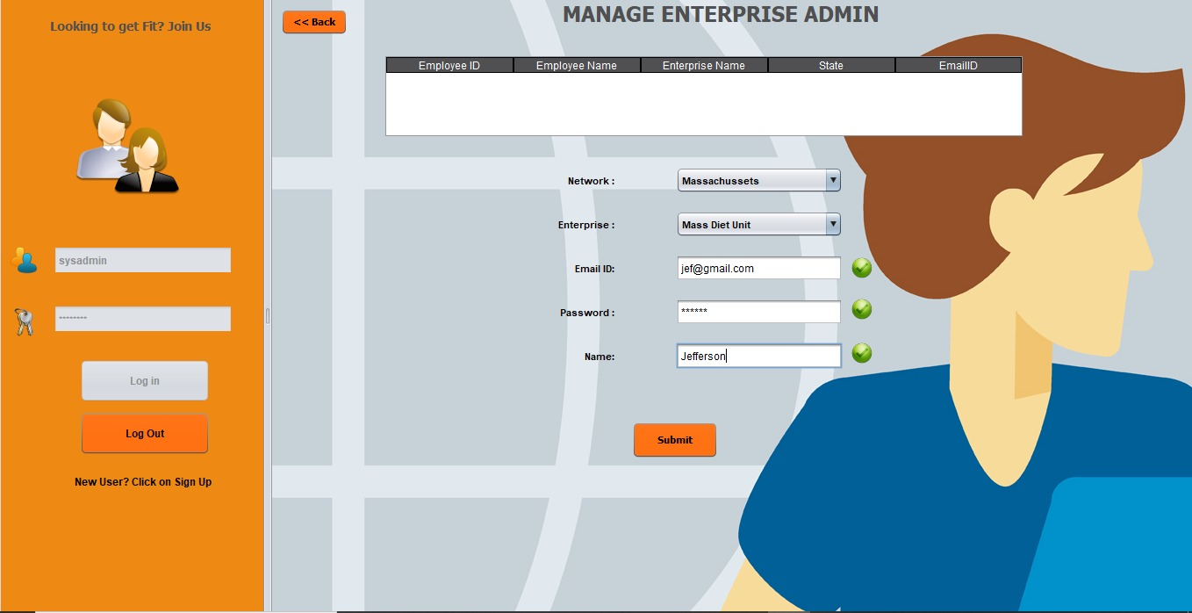
MANAGING ENTERPRISE ADMINISTRATOR

Slide 11
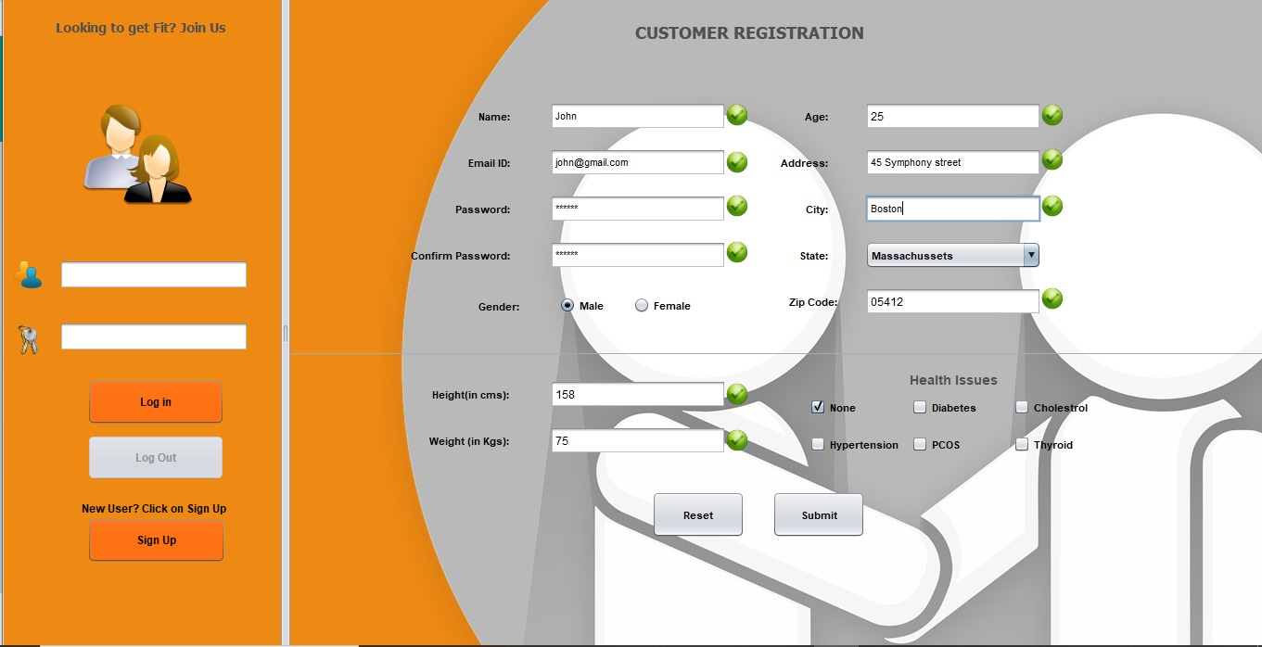
CUSTOMER REGISTRATION

Slide 12
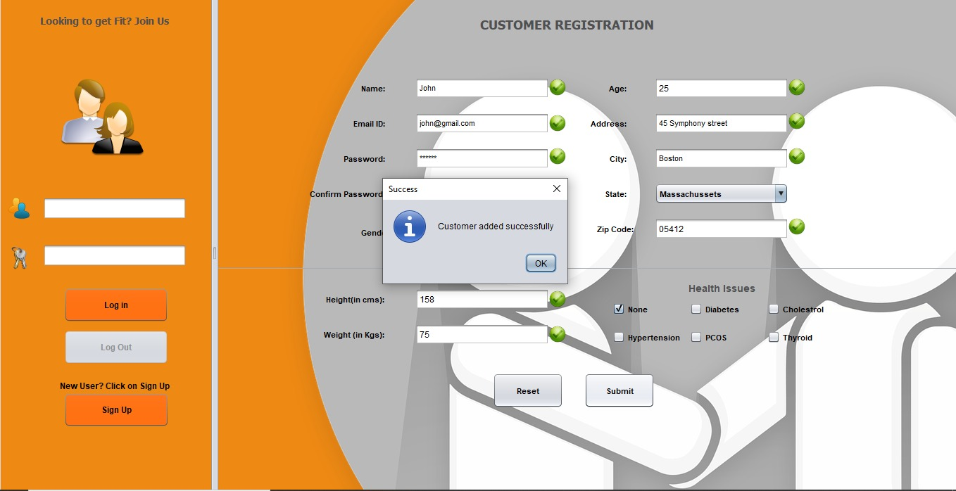
CUSTOMER REGISTRATION

Slide 13
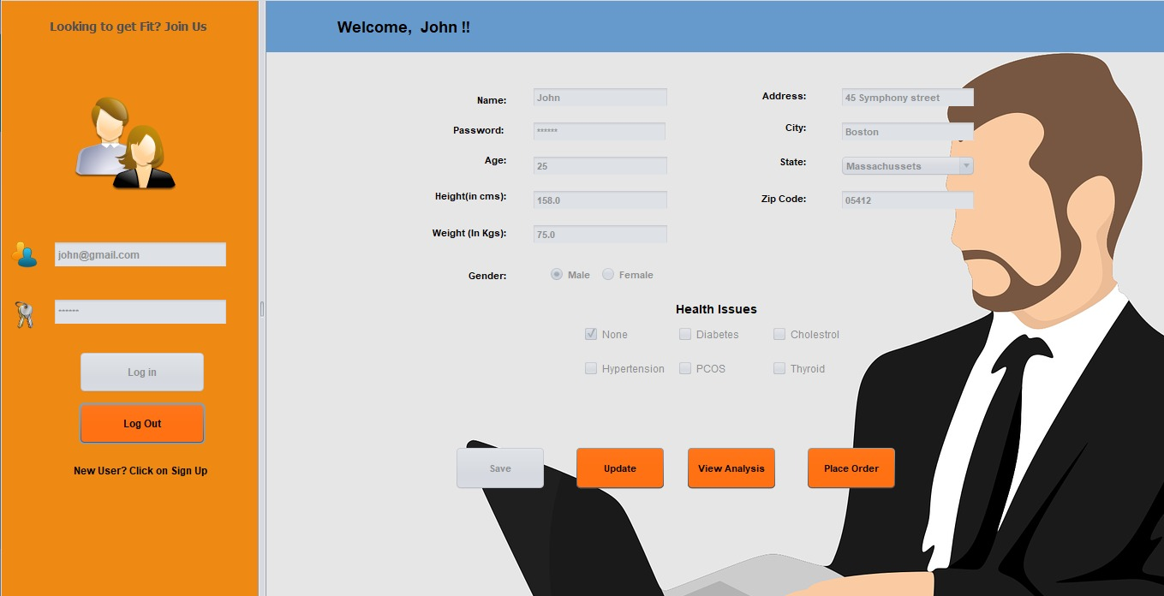
CUSTOMER LANDING PAGE

Slide 14
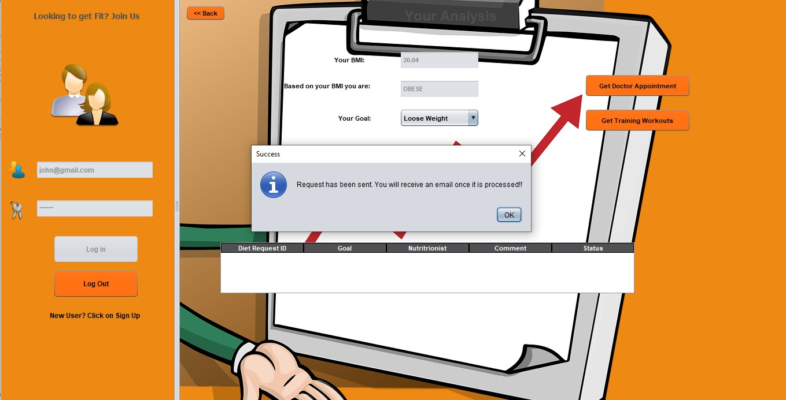
CUSTOMER REQUEST TO NUTRITIONIST

Slide 15
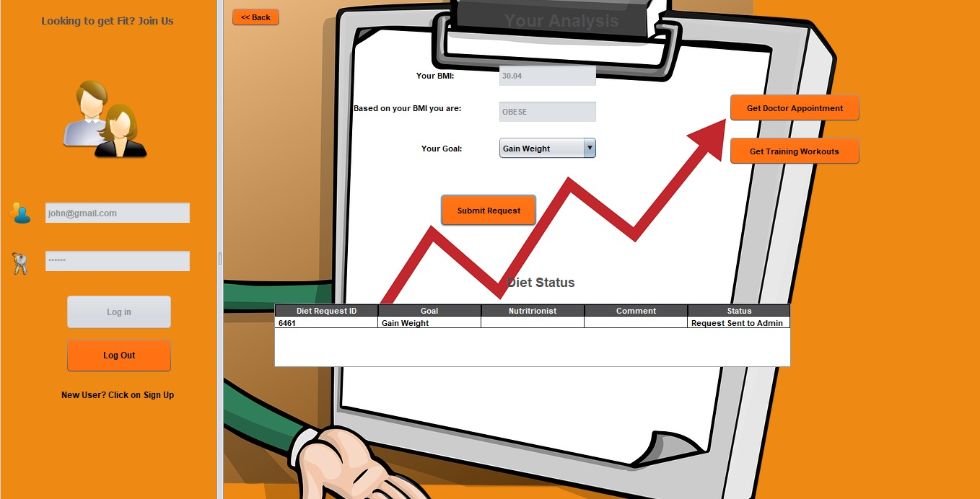
CUSTOMER REQUEST STATUS

Slide 16
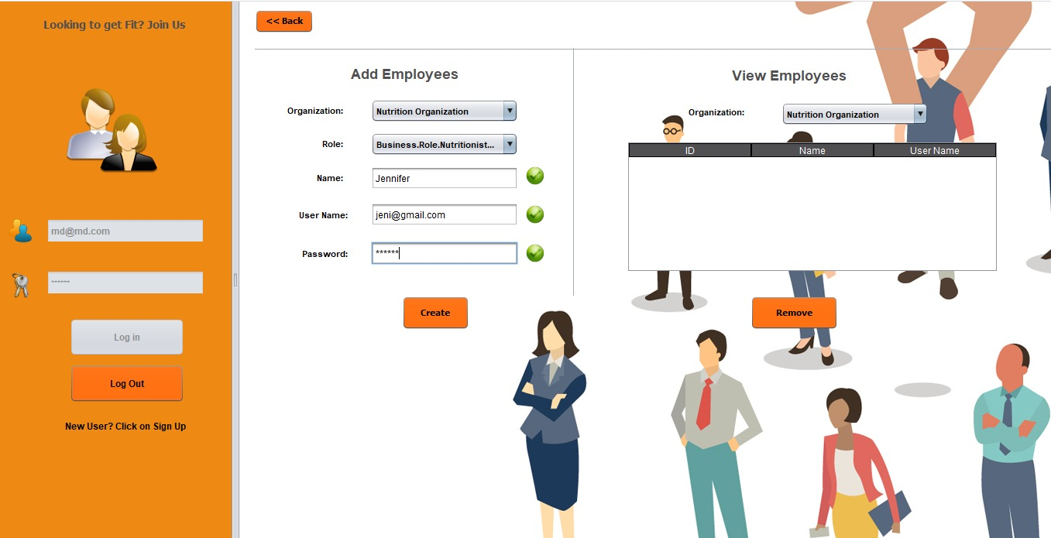
MANAGE EMPLOYEES

Slide 17
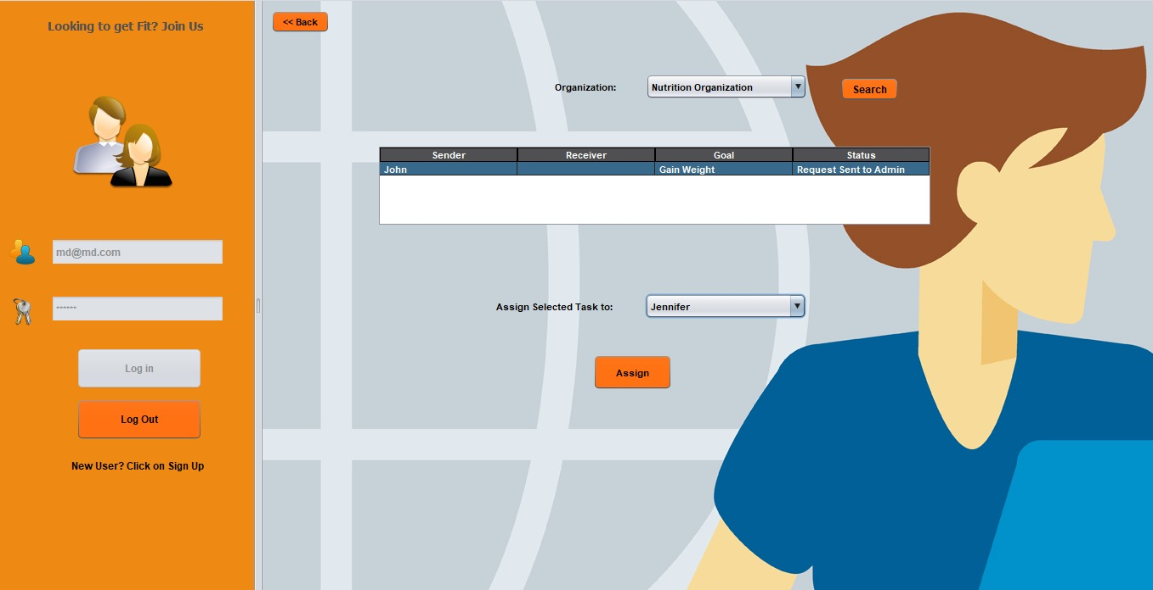
MANAGE REQUESTS

Slide 18
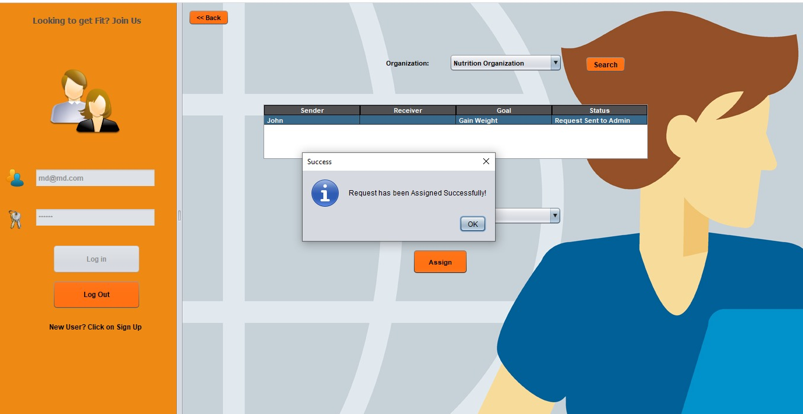
ENTERPRISE ADMINISTRATOR REQUEST MANAGEMENT

Slide 19
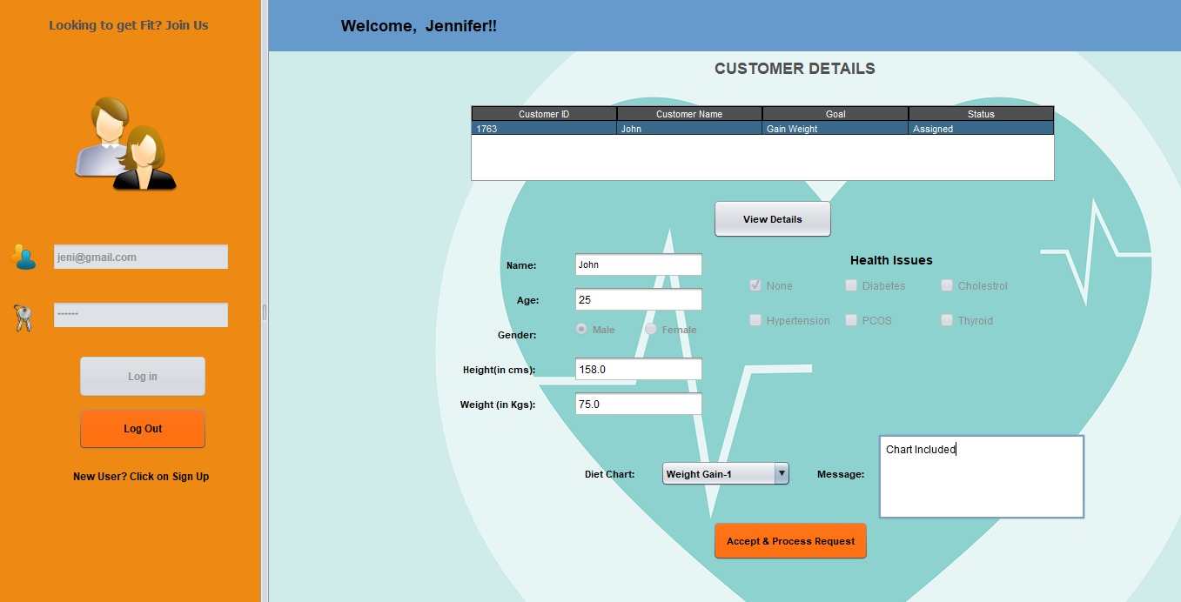
NUTRITIONIST LANDING PAGE

Slide 20
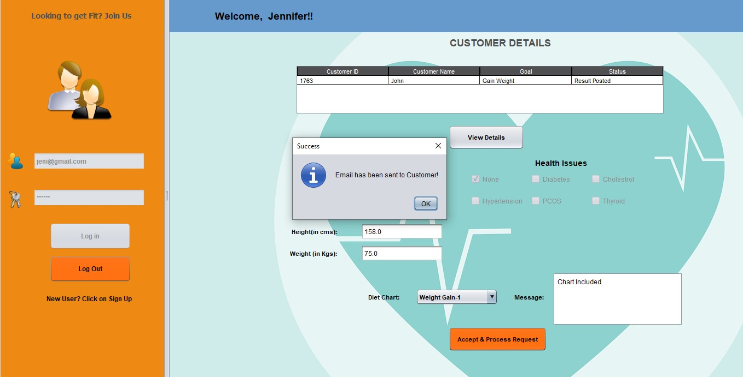
NUTRITIONIST PROCESSING REQUEST

Slide 21
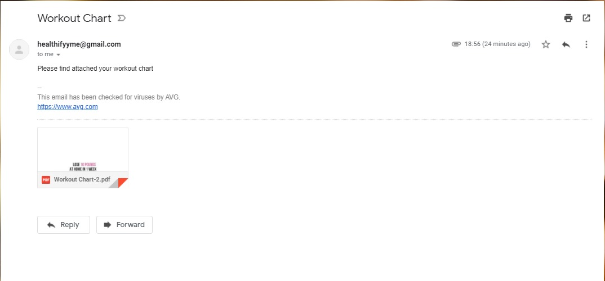
CUSTOMER RECEIVING THE CHART VIA EMAIL

Slide 22

THANK YOU

